Slide 1

Chapter 6: Qualitative Process Analysis
Contents
Value-Added Analysis
Waste Analysis
Stakeholder Analysis & Issue Documentation
Root-Cause Analysis
Recap

Slide 2
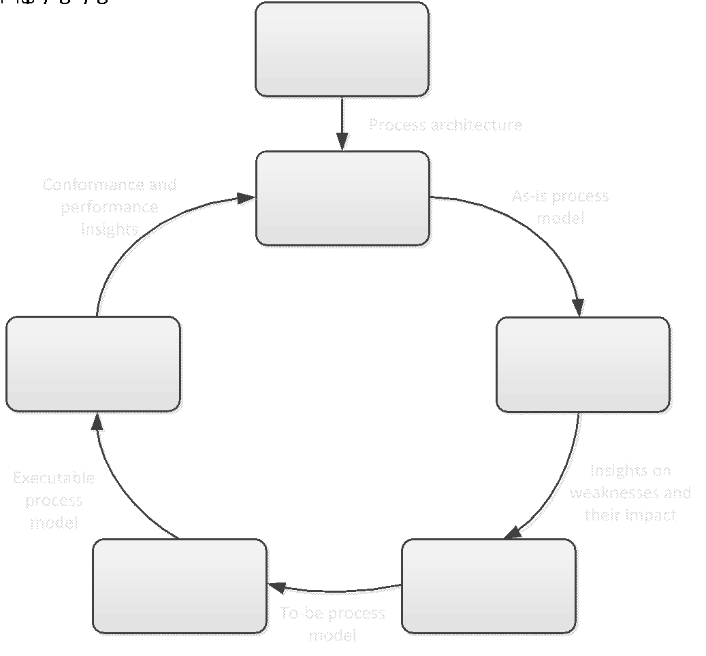
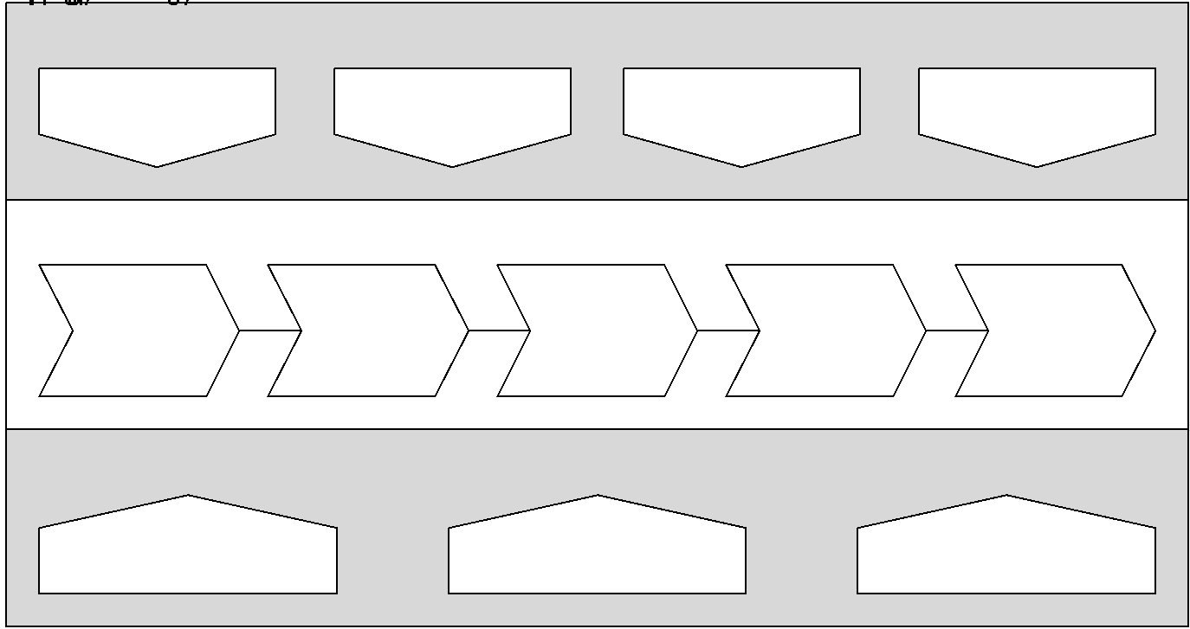
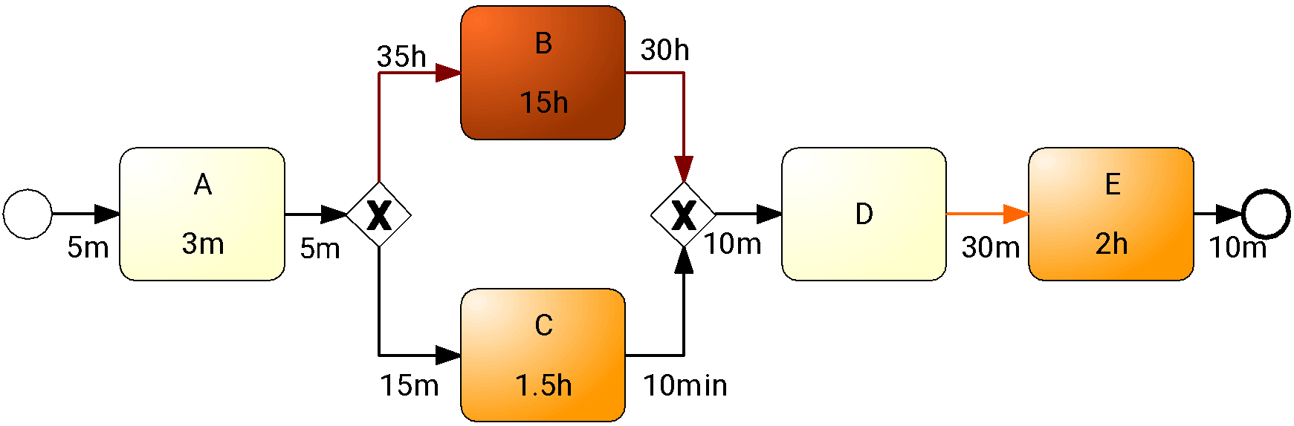

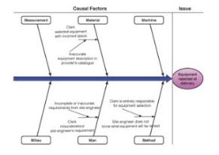
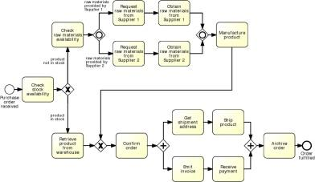

Process Analysis in the BPM Lifecycle

Slide 3
Qualitative Process Analysis: Overview
Stakeholder analysis
Value-Added & Waste Analysis
Root-Cause Analysis
Issue Register & Pareto Chart

Slide 4
Chapter 6: Qualitative Process Analysis
Contents
Value-Added Analysis
Waste Analysis
Stakeholder Analysis & Issue Register
Stakeholder Analysis
Issue Register
Pareto & PICK Chart
Recap

Slide 5
Identifying and documenting process issues
Stakeholder analysis: allows us to collect issues from complementary perspectives.
Issue register: allows us to document issues and their impact in a structured manner
Pareto analysis and PICK charts: allow us to select a subset of issues for further analysis and redesign.

Slide 6
Stakeholder Analysis
Stakeholder analysis is about gathering data from multiple sources by interviewing stakeholders of different types and reconciling their viewpoints
In BPM, stakeholder analysis is commonly used to gather information
about issues that affect the performance of the process from different perspectives.
There are typically five categories of stakeholders:
The customer(s) of the process.
The process participants.
The external parties (e.g., suppliers, sub-contractors) involved in the process.
The process owner and the operational managers who supervise the process participants.
The sponsor of the process improvement effort and other executive managers who have a stake in the performance of the process.

Slide 7
Typical Stakeholder Concerns
Customers are often concerned about slow cycle time, defects, lack of transparency, or lack of traceability (inability to observe the current process status).
Process participants might be rather concerned about:
High resource utilization, working under stress.
Defects arising from handoffs in the process and wastes.
External parties (e.g. suppliers and sub-contractors) are generally concerned about having a steady or growing stream of work from the process, being able to plan their work ahead, and being able to meet contractual requirements.
The process owner is usually concerned with performance, be it high cycle times or high processing times. Also be concerned about common defects and wastes, and compliance with internal policy and external regulations.
The sponsor and other high-level managers are generally concerned with the strategic alignment of the process and the contribution of the process to key performance indicators. Also concerned about the ability of the process to adapt to evolving customer expectations, competition, and market conditions.

Slide 8
Issue register
Purpose: to maintain, organize and prioritize perceived weaknesses of the process (issues)
Sources of issues:
Input to a process modelling project
Collected as part of ongoing process improvement actions
Collected during process discovery (modelling)
Value-added/waste analysis

Slide 9
Issue register structure
Can take the form of a table with:
Issue identifier
Short name
Description
Assumptions
Impact: Qualitative and Quantitative
Possible improvement actions
Larger process improvement projects may require issue trackers

Slide 10
Example of an issue documentation
Issue name
Equipment kept longer than needed
Description
Site engineers keep rented equipment longer than needed by asking for deadline extensions
Assumptions
3000 pieces of equipment rented p.a.
In 10% of cases, equipment is kept two days more than needed
Average rental cost is 100 per day
Quantitative impact
0.1 × 3000 × 2 × 100 = 60,000 p.a

Slide 11
Issue Register Example
Name | Explanation | Assumptions | Qualitative Impact | Quantitative Impact
Equipment kept longer than needed | Site engineers keep equipment longer than needed via deadline extensions | 3000 pieces of equipment rented p.a. In 10% of cases, equipment kept two days longer than needed. Rental cost is 100 per day |  | 0.1 × 3000 × 2 × 100 = 60,000 p.a.
Rejected equipment | Site engineers reject delivered equipment due to non-conformance to their specifications | 3000 pieces of equipment rented p.a. 5% of them are rejected due to an internal mistake For each equipment rejected due to an internal mistake, BuildIT is billed 100. | Disrupted schedules. Employee stress and frustration | 3000 × 0.05 × 100 = 15,000 p.a.
Late payment fees | Late payment fees incurred because invoices are not paid by their due date | 3000 pieces of equipment rented p.a. Average rental time is 4 days Rental cost is 100 per day. Each rental leads to one invoice. About 10% of invoices are paid late. Penalty for late payment is 2%. | Poor reputation with suppliers | 0.1 × 3000 × 4 × 100 × 0.02 = 2400 p.a.

Slide 12
Pareto chart
Useful to prioritize a collection of issues
Bar chart where the height of the bar denotes the impact of each issue
Bars sorted by impact
Superposed curve of cumulative percentage impact

Slide 13
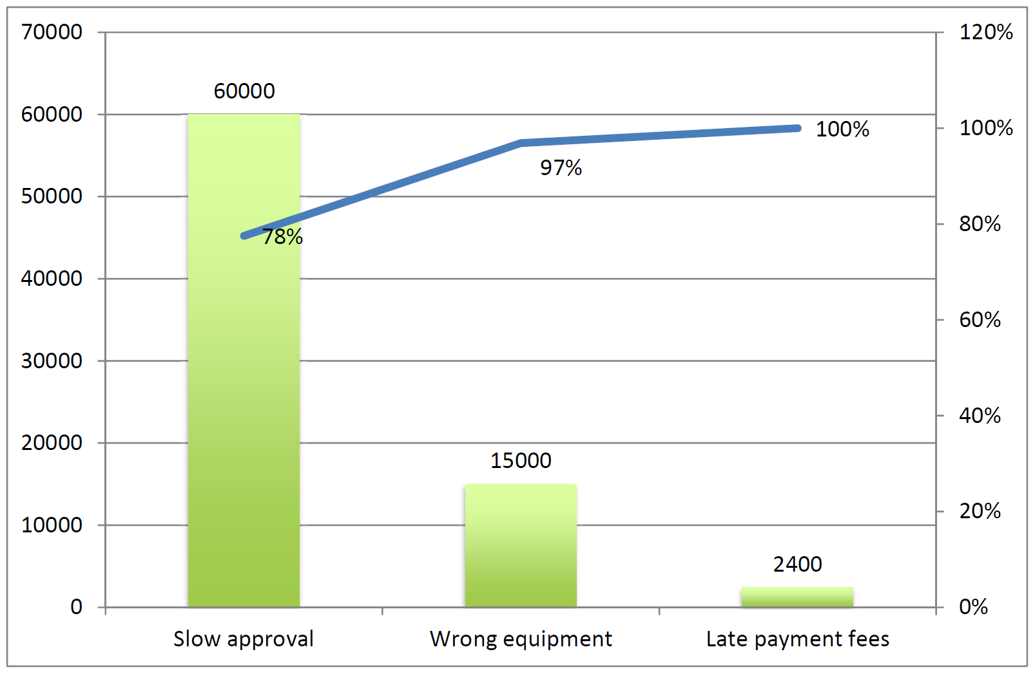
Pareto chart example

Slide 14
Exercise
Pharmacy prescription process (Exercise 1.6)
Identify and document at least two issues in an issue register

Slide 15
Chapter 6: Qualitative Process Analysis
Contents
Value-Added Analysis
Waste Analysis
Stakeholder Analysis & Issue Register
Root-Cause Analysis
Cause-Effect Diagram
Why-Why Diagram
Recap

Slide 16
Root-cause analysis
Why-why diagram
Factors
Issue
Cause-effect diagram

Slide 17
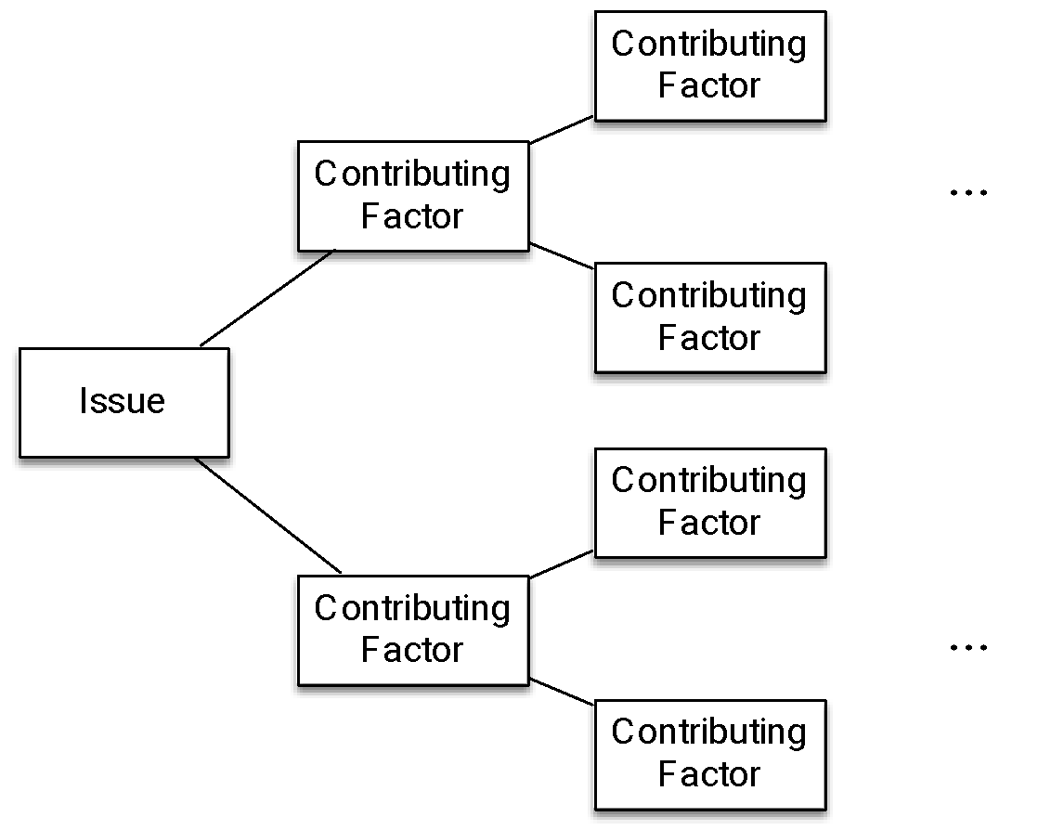
Why-why diagram
Five levels of nesting
“Five Why’s”

Slide 18
Why-why diagram example
Site engineers keep equipment longer, why?
Site engineer fears that equipment will not be available later when needed, why?
time between request and delivery too long, why?
excessive time spent in ﬁnding suitable equipment and approving the request, why?
time spent by clerk contacting possibly multiple suppliers sequentially;
time spent waiting for works engineer to check the requests;

Slide 19
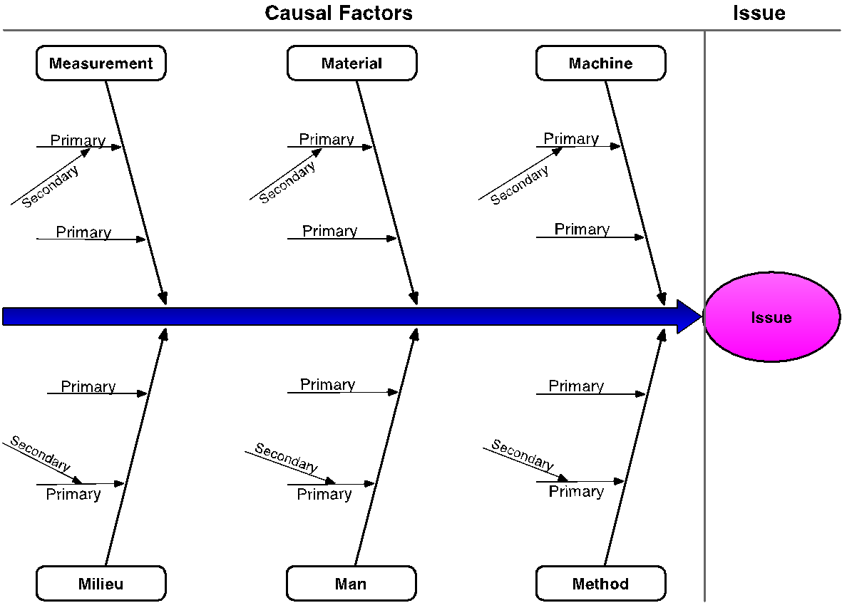
Cause-effect (Fishbone) diagram

Slide 20
Categories of causes: Six Ms
Machine: factors stemming from technology used
Lack of suitable functionality in the supporting software applications
Poor User Interface (UI) design
Lack of integration between systems
Method: factors stemming from the way the process is designed, understood or performed
Unclear assignments of responsibilities
Unclear instructions
Insufficient training
Lack of timely communication
Material: factors stemming from input materials or data
Missing, incorrect or outdated data

Slide 21
Categories of causes: Six Ms
Man: factors stemming from wrong assessments or incorrect performance of steps attributable to:
Lack of training and clear instructions
Lack of motivation
Too high demands towards process workers
Measurement: factors stemming from reliance on:
Inaccurate estimations
Miscalculations
Milieu: factors outside the scope of the process
Delays caused because of unresponsive external actors
Sudden increases of workload due to special circumstances

Slide 22
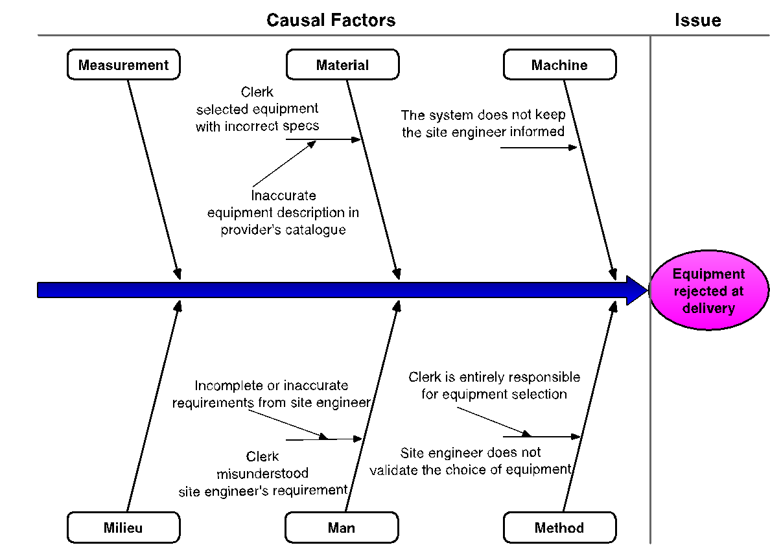
Cause-effect diagram example

Slide 23
Exercise
Pharmacy prescription process (Exercise 1.6)
Select one of the previously identified issues and analyze it using a why-why diagram

Slide 24
Chapter 6: Qualitative Process Analysis
Contents
Value-Added Analysis
Waste Analysis
Stakeholder Analysis & Issue Documentation
Root-Cause Analysis
Recap

Slide 25
Recap
Segregate value-adding, business value-adding and non-value-adding steps
Identify waste: move, hold, overdo
Collect and systematically organize issues, assess their impact, priotirize
Analyze root causes of issues

